Slide 1
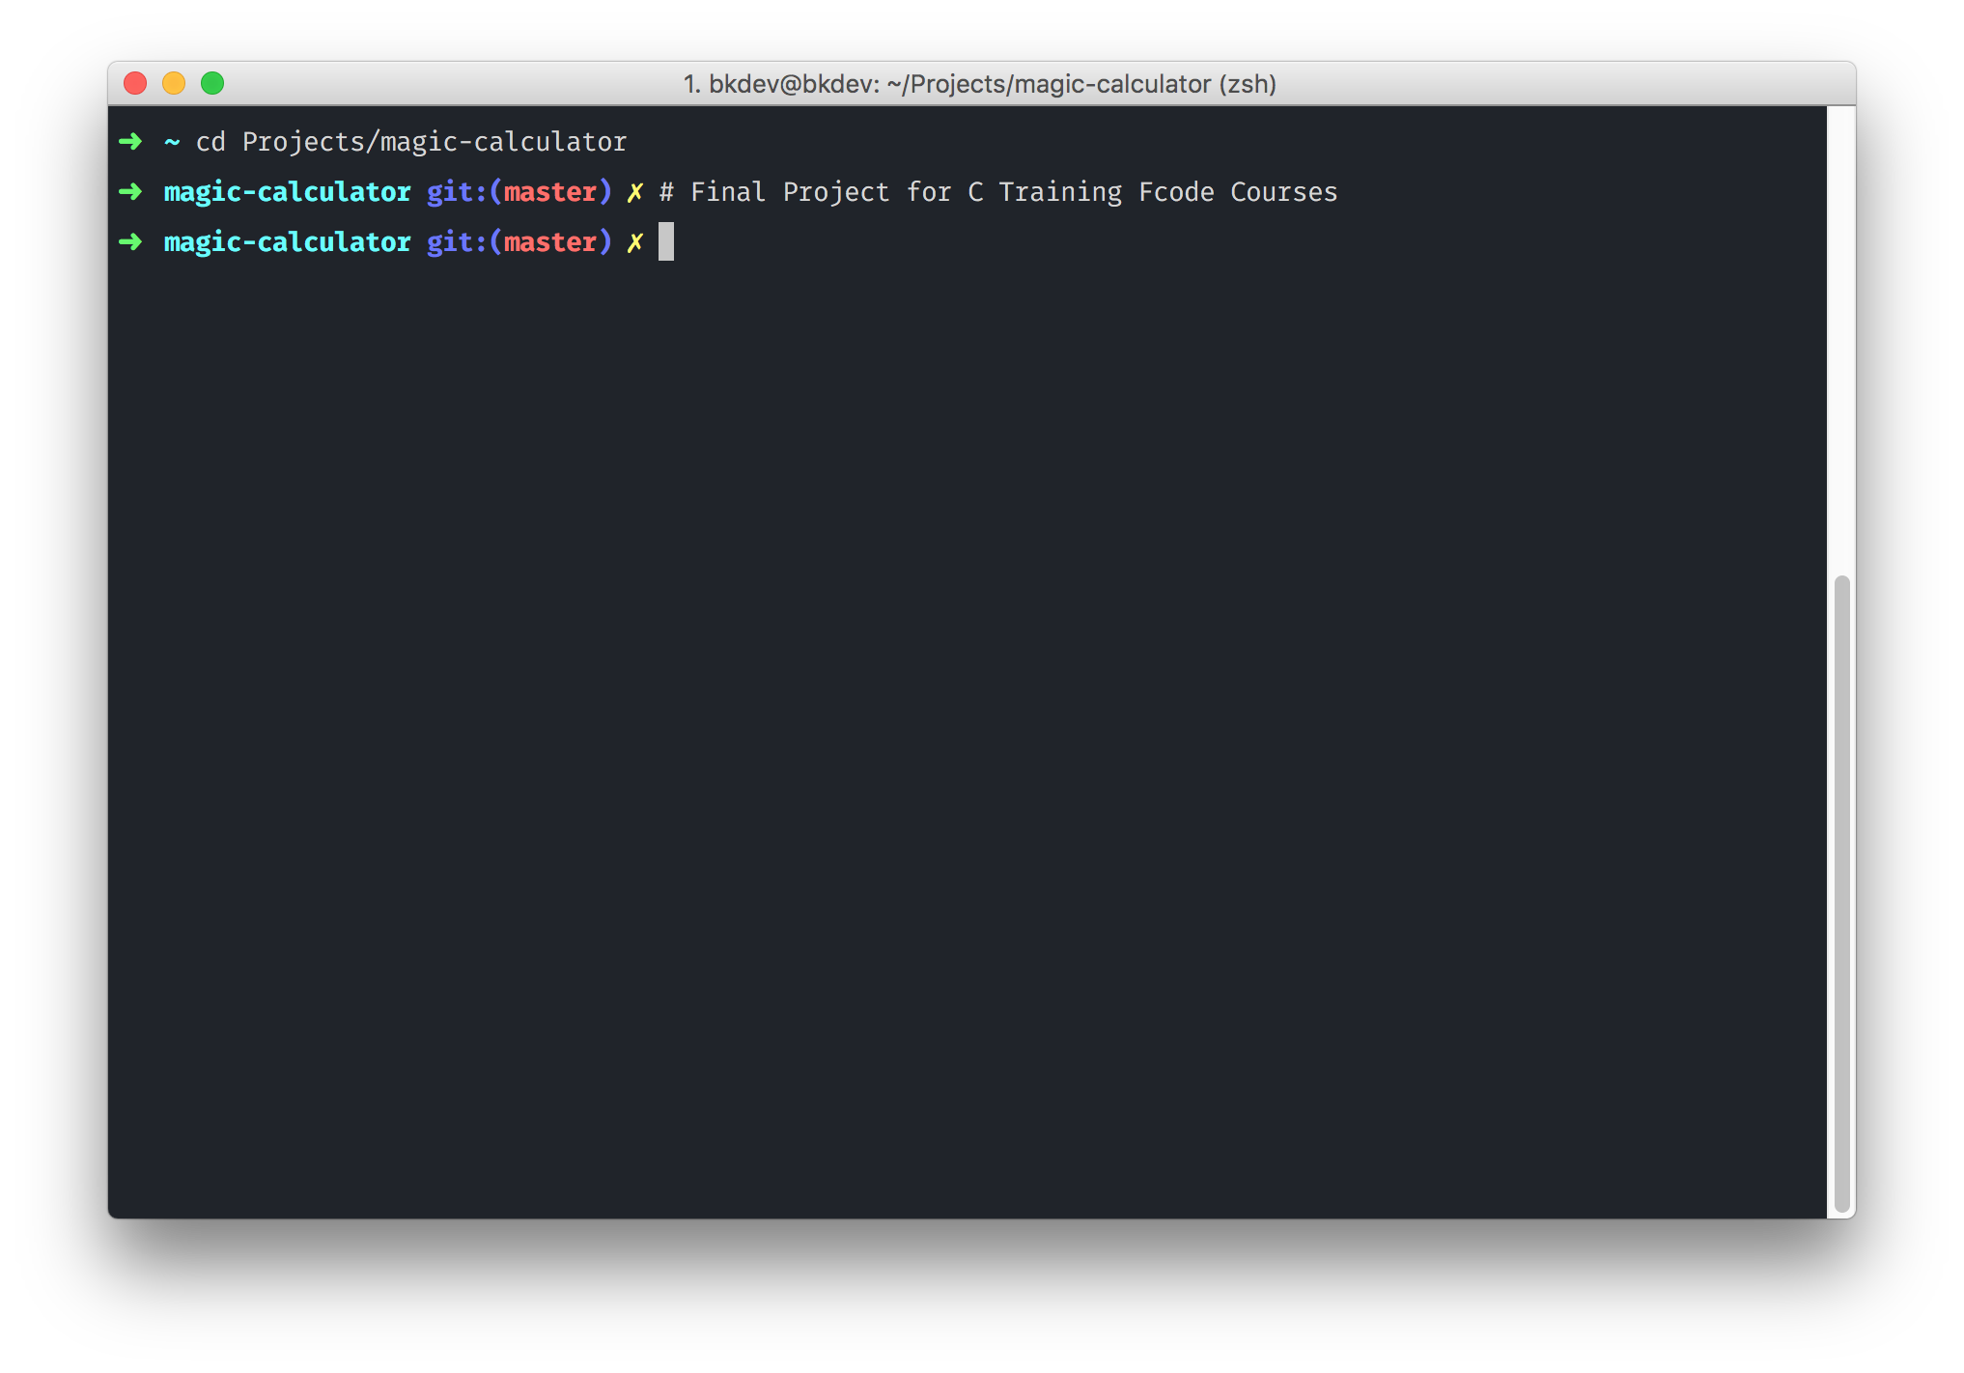

Slide 2
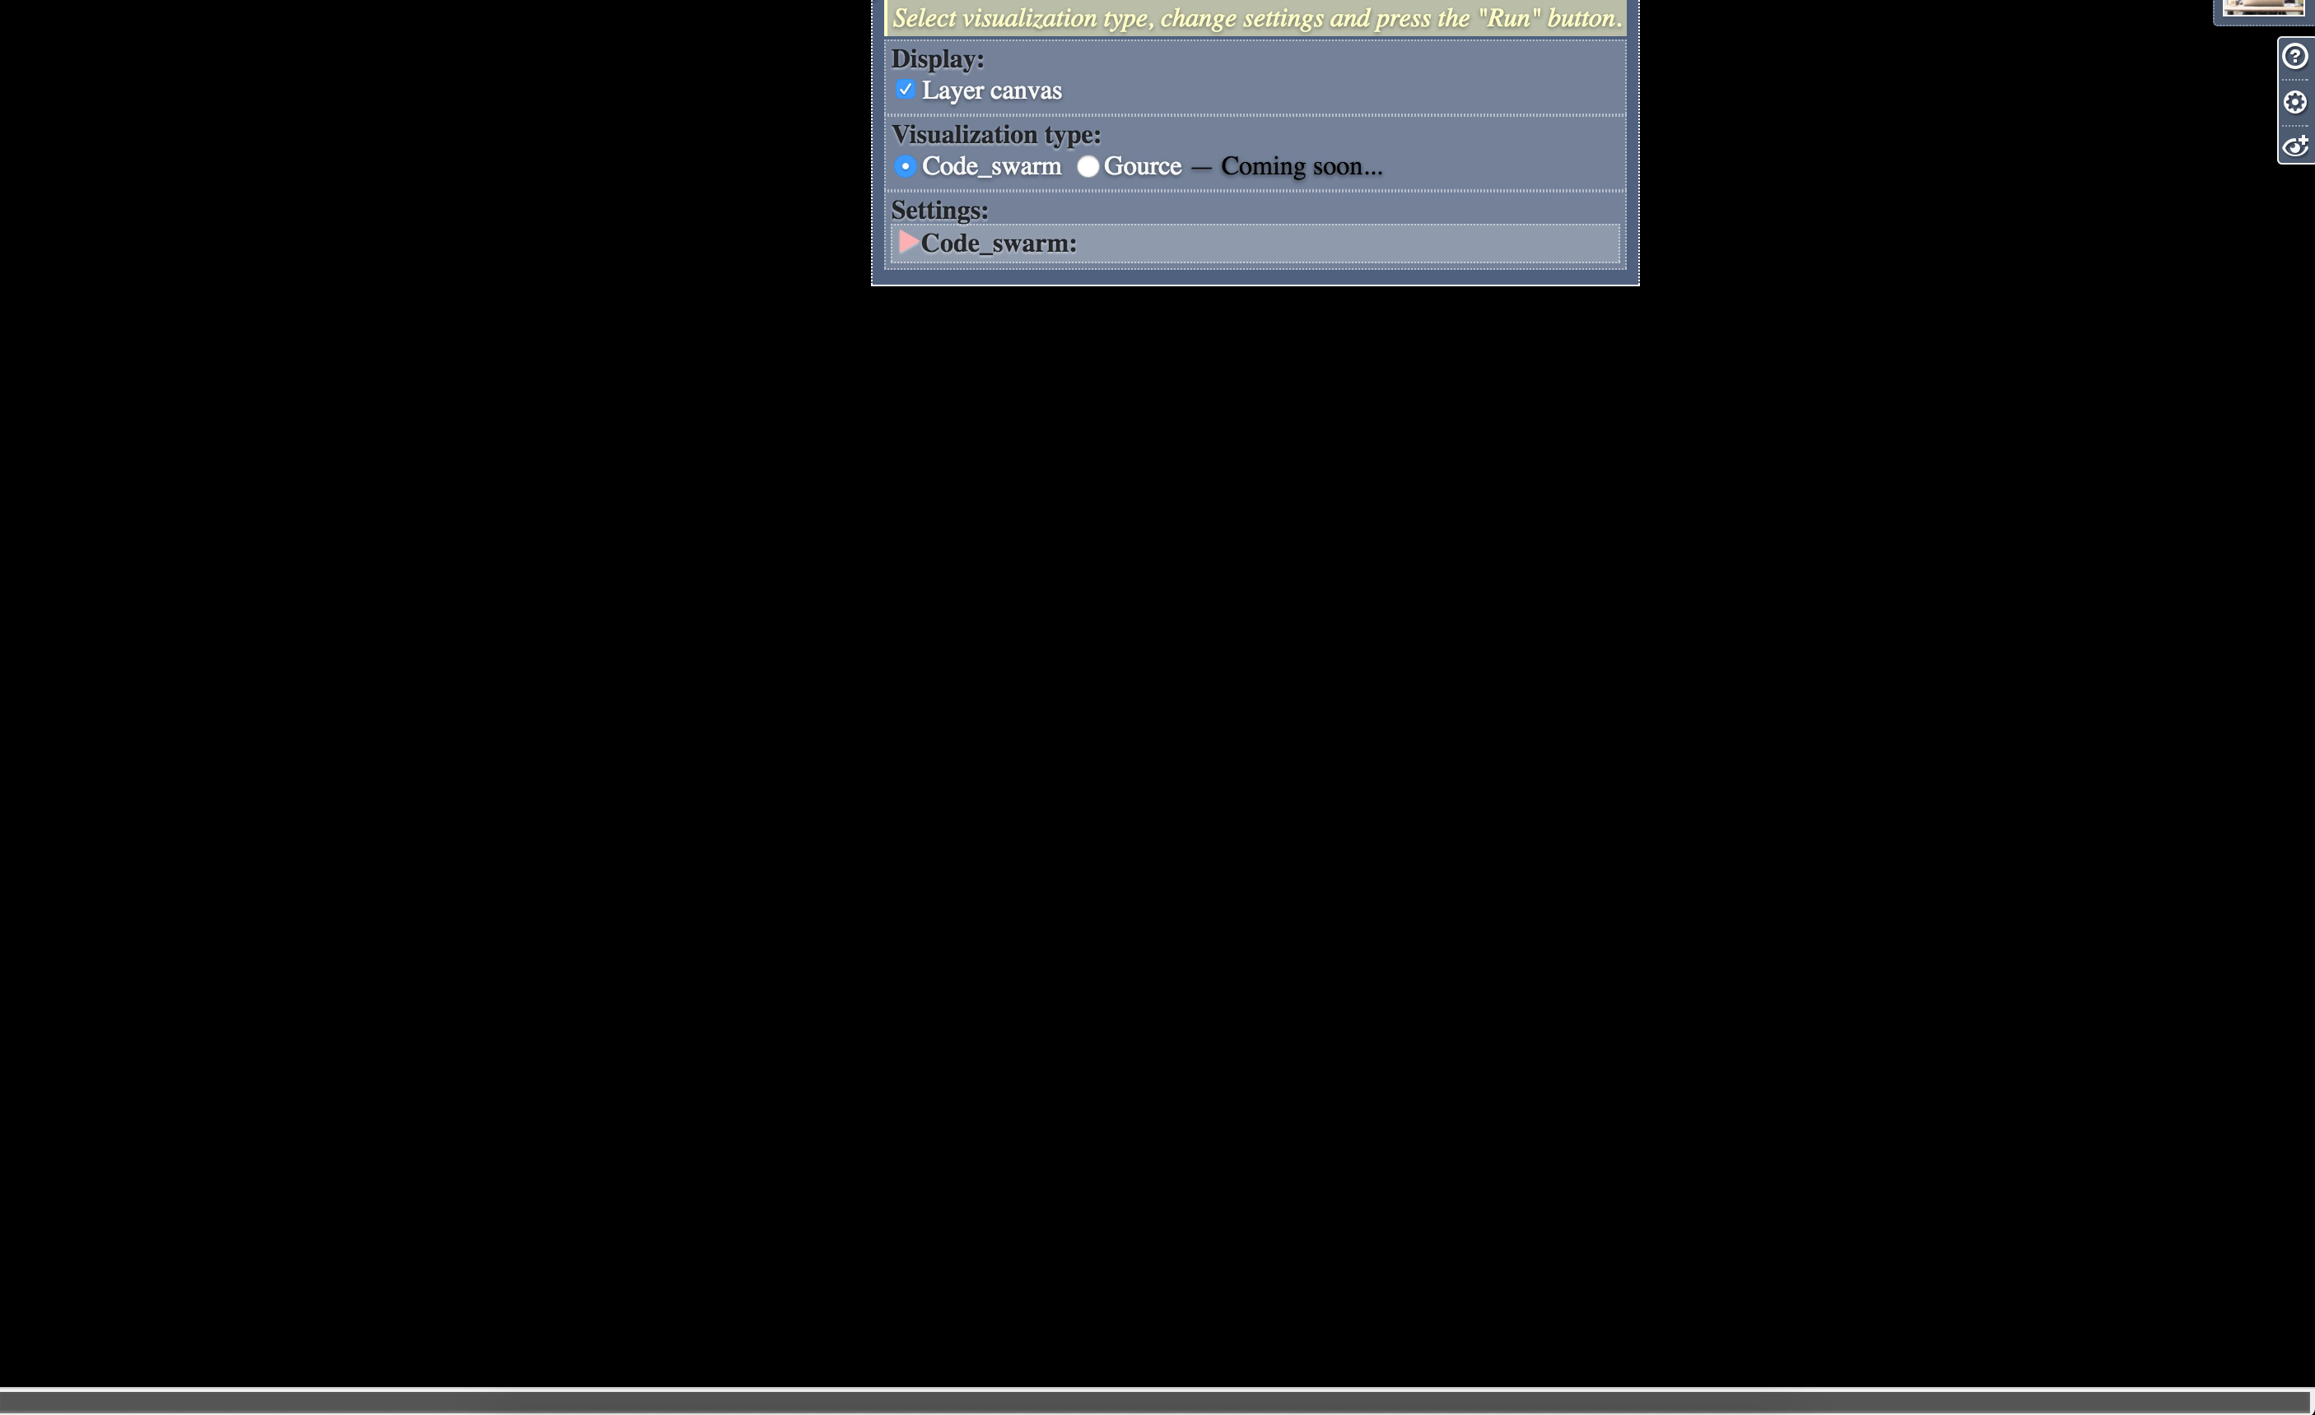
Contributions

Slide 3
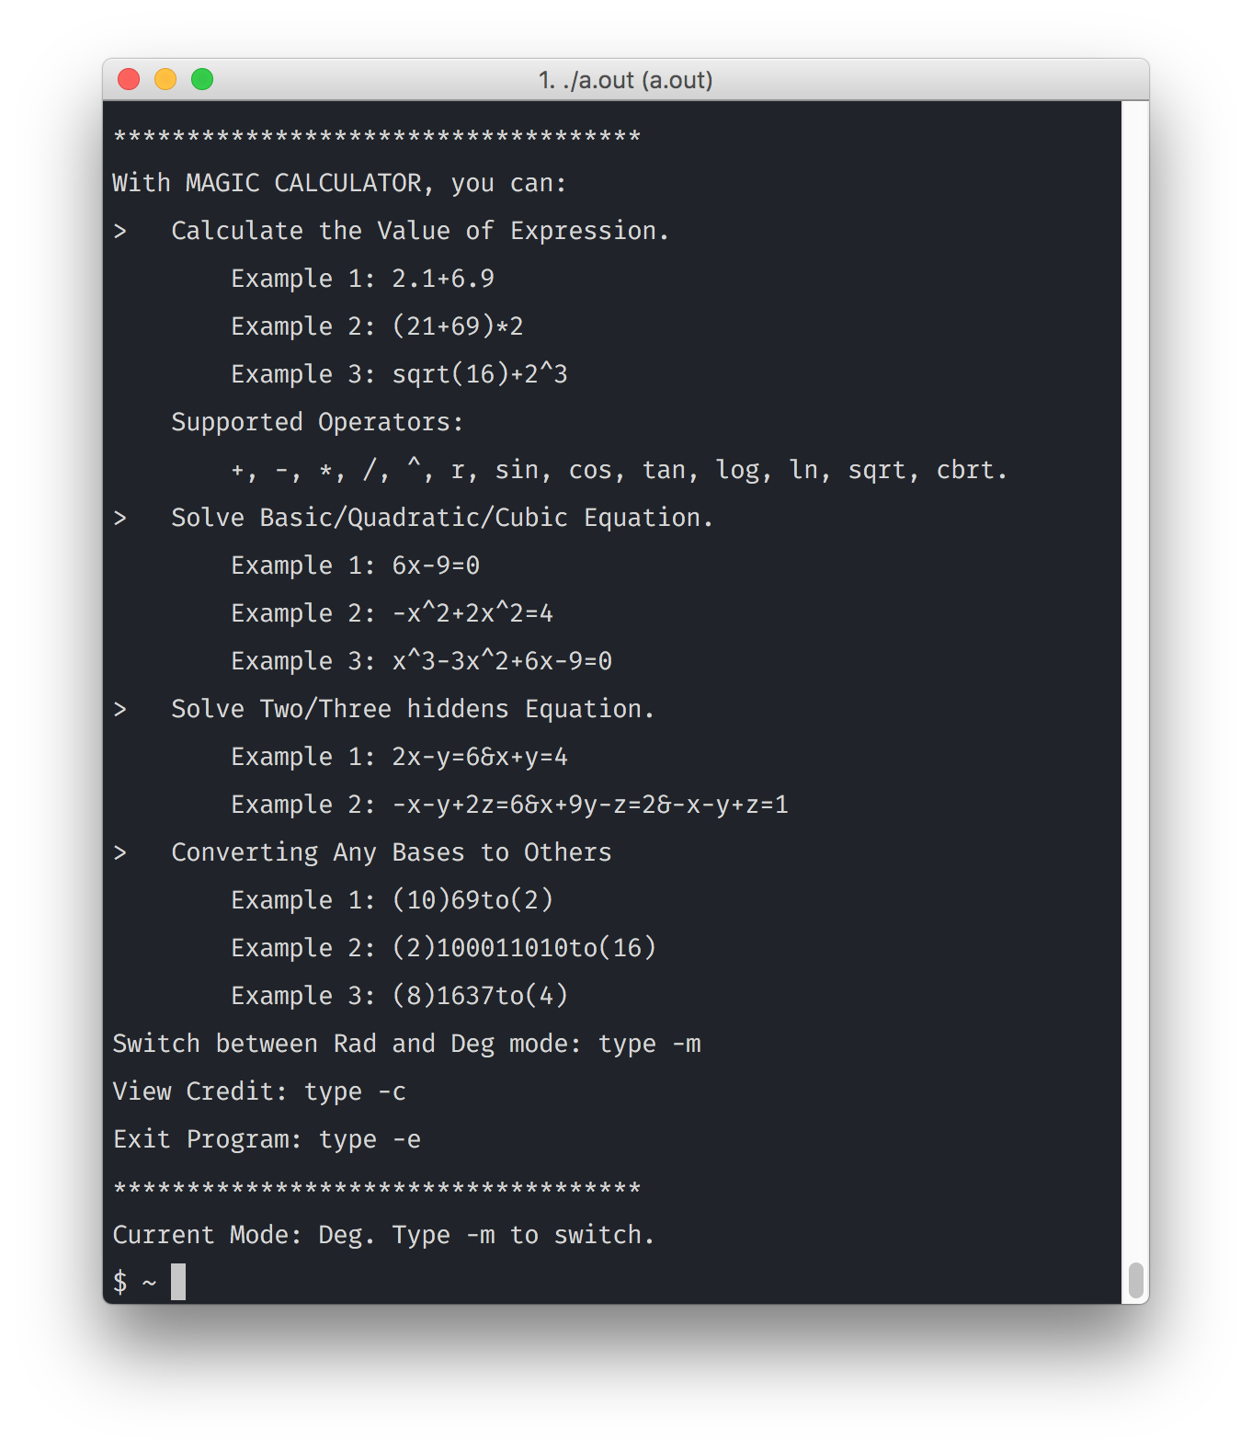
Functions

Slide 4

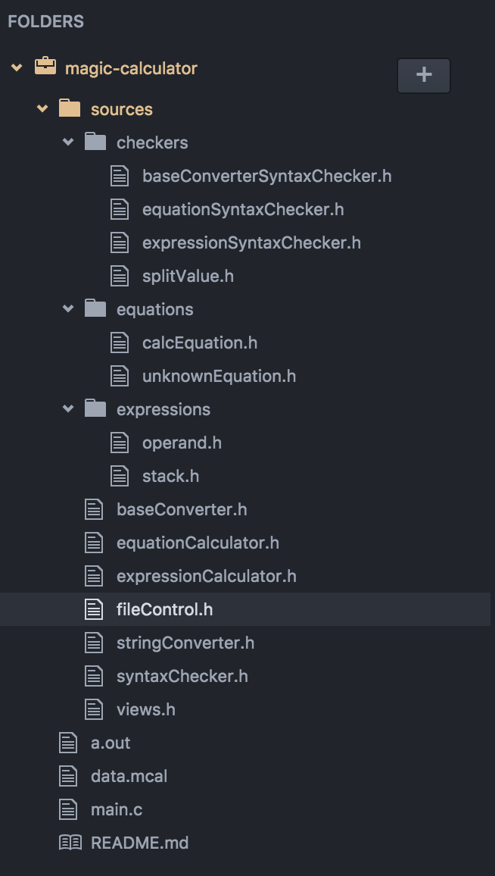
App Structure

Slide 5
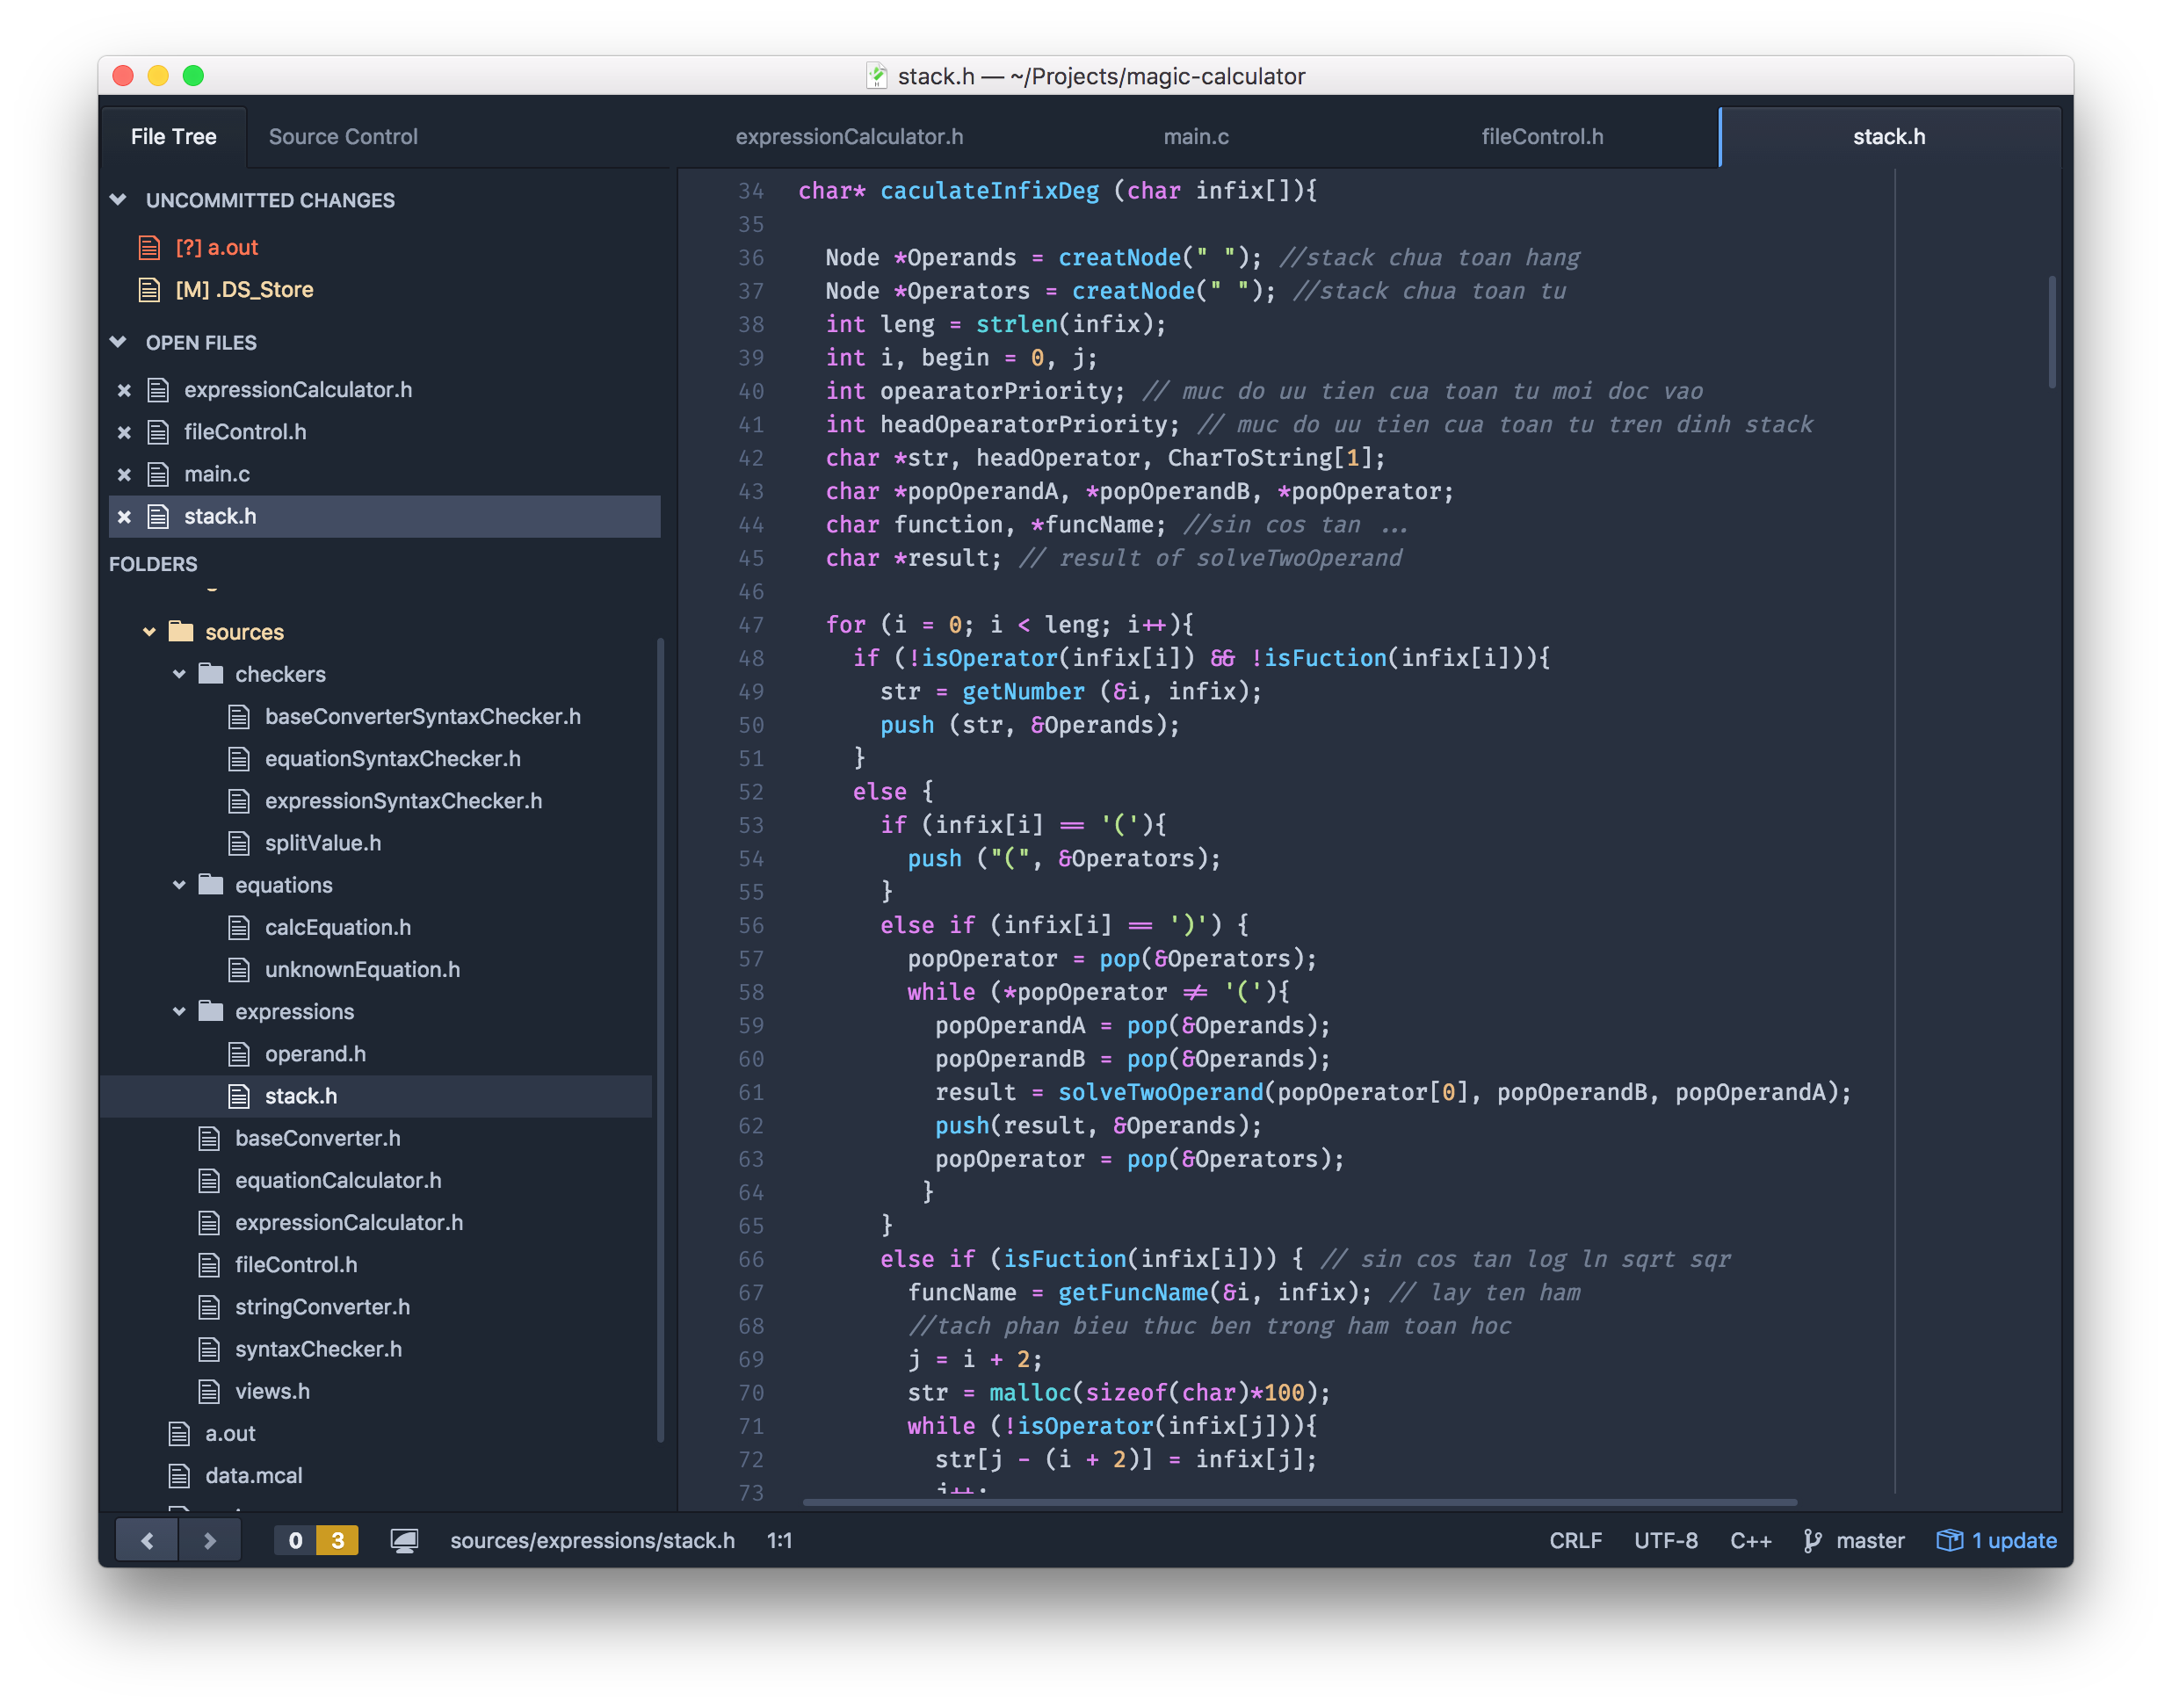
Created by things we learned together with Fcode <3

Slide 6

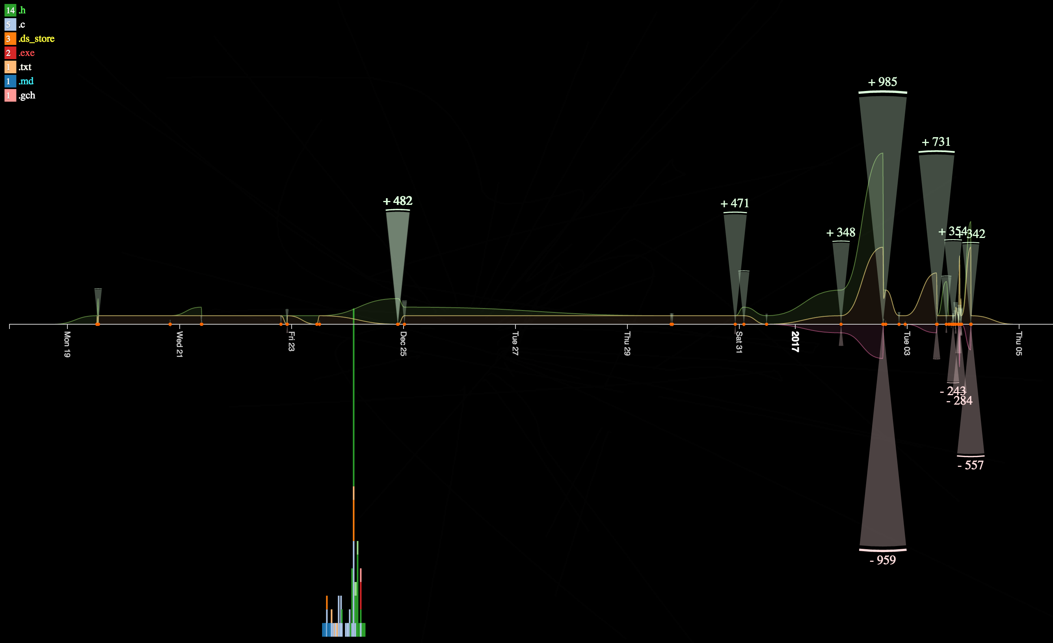
From idea to magic…

Slide 7
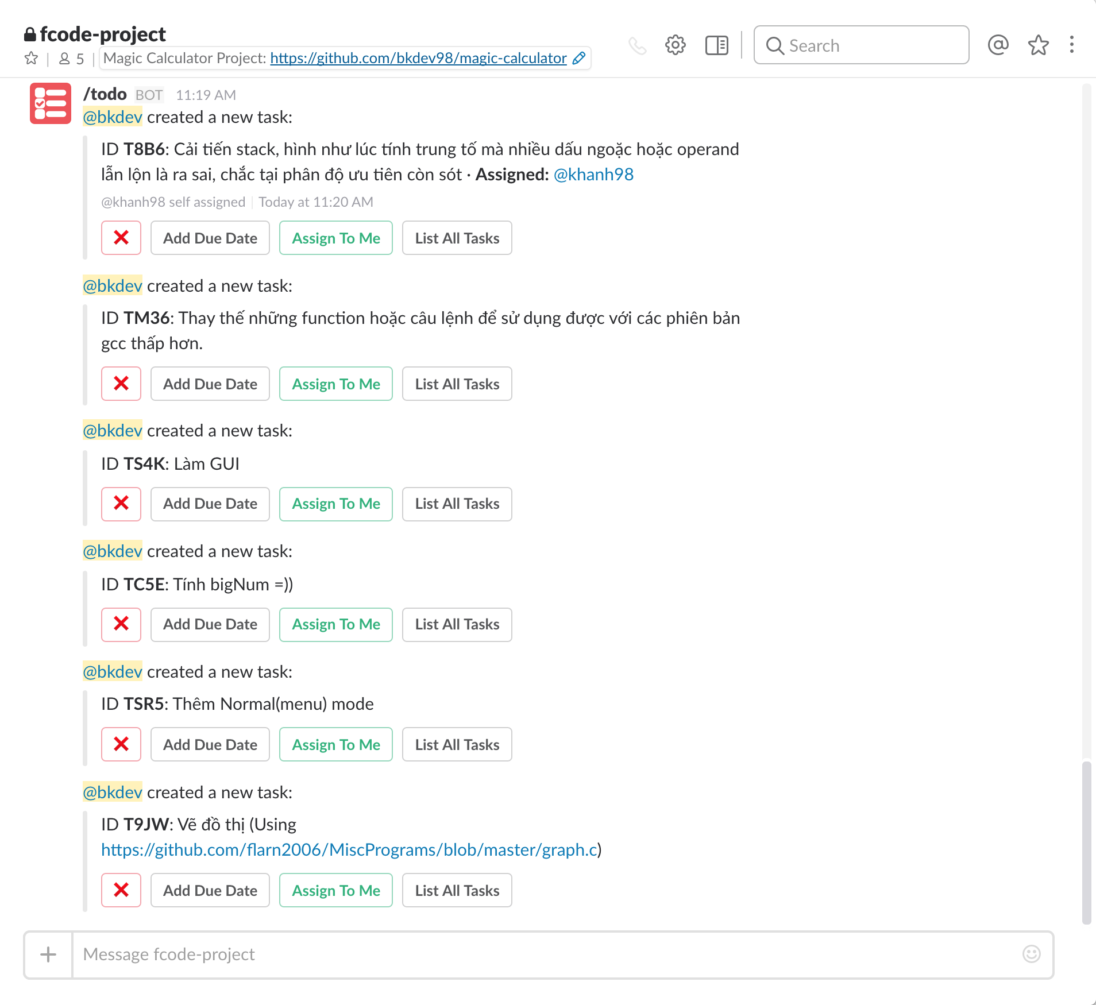
Keep magic being magic…

Slide 8
Specially thanks to fcode!

